Slide 1
COFFEE MANAGEMENT SYSTEM
GROUP 7 – ADVANCED PROGRAMMING WITH PYTHON

Slide 2
Content
01
Group
Coffee Management System
STRUCTURE OF CODE
02
Classes
Modules and Packages
Database Diagram
CONCLUSION
03
Demo
Conclusion

Slide 3
Introduction Group
BI10-031
ICT
BI10-156
ICT
Nguyễn Quốc Hùng
Nguyễn Hoàng Nam
Nguyễn Tiến Đạt
Nguyễn Minh Đức
Lương Nguyễn Việt Sơn
Your Text
BI10-072
ICT
BI10-123
ICT
Example Text :
Get a modern PowerPoint Presentation that is beautifully designed.
BI10-028
ICT

Slide 4
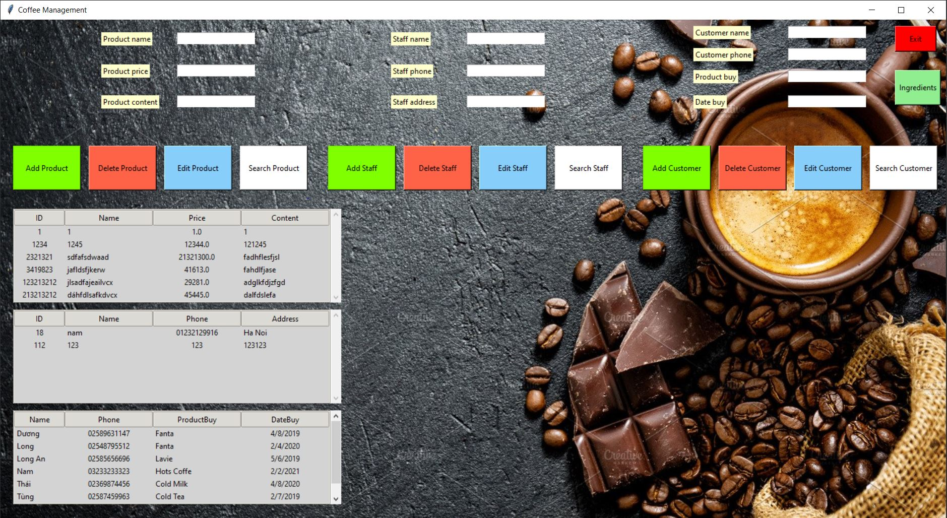
COFFEE MANAGEMENT SYSTEM

Slide 5
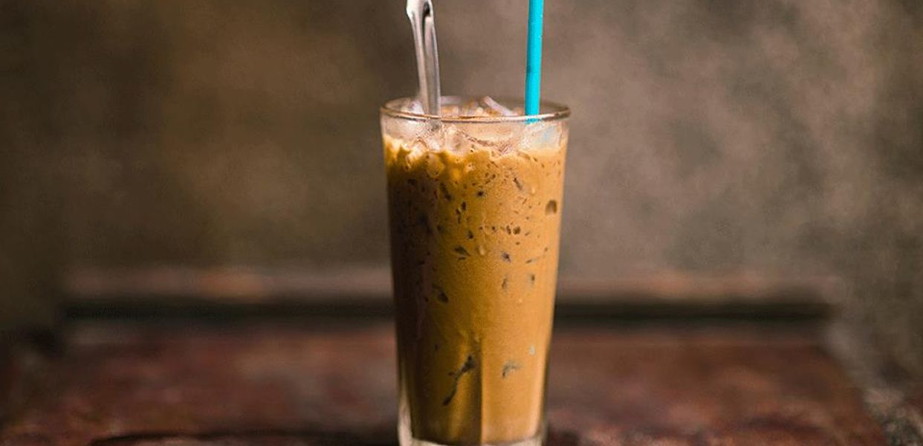
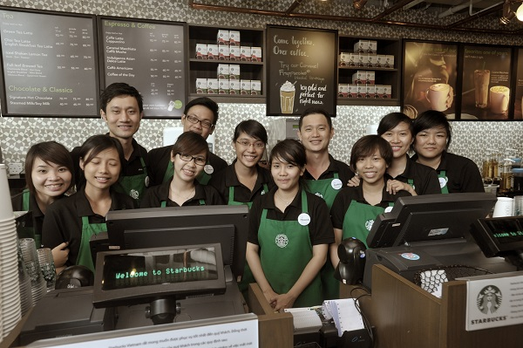

Structure
1.CLASSES
In our code , we create 3 classes called ‘Customer’ , ‘Product’ and ‘Staff .

Slide 6

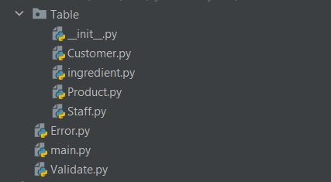

Structure
2. Module and Package
We divide our code into many modules and packages

Slide 7
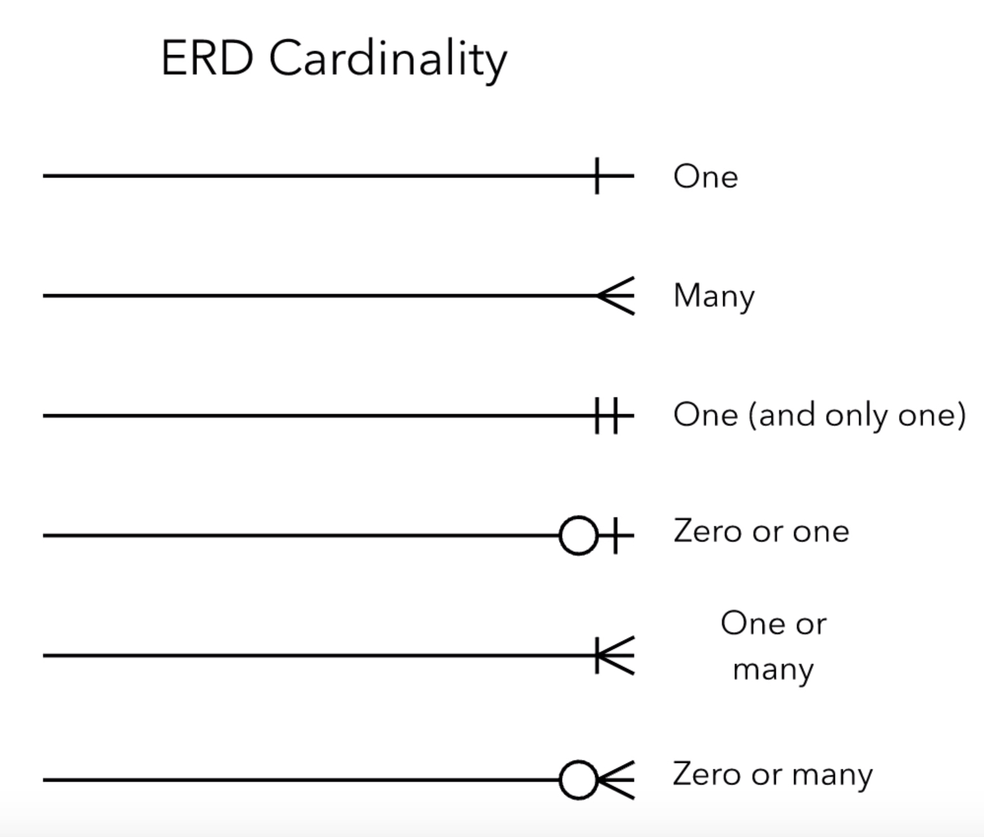
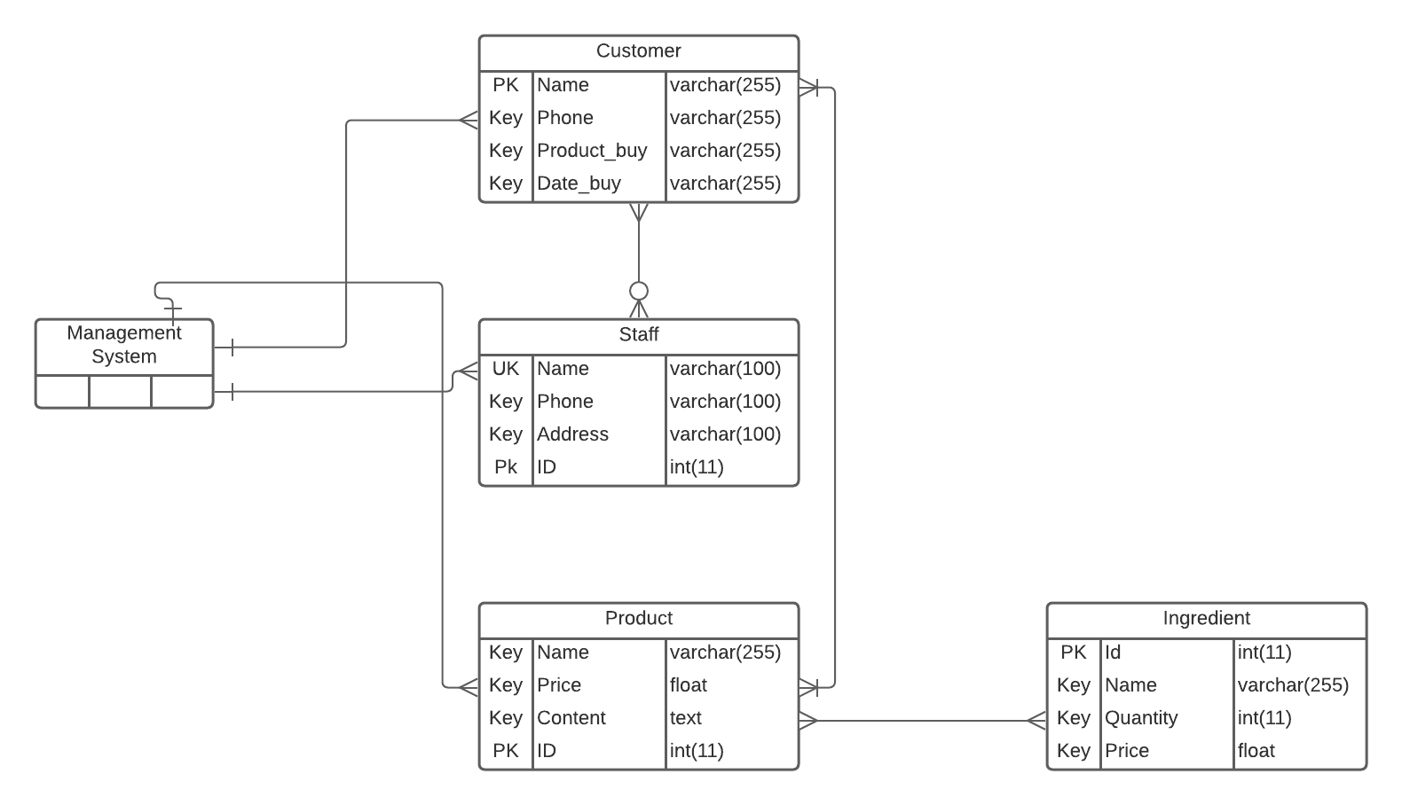
Structure
3. Database Diagram
With A Management System , Database Diagram is very important

Slide 8
CONCLUSION

Slide 9
DEMO
Coffee Management System

Slide 10
THANK YOU
For listening our presentation

